Slide 1
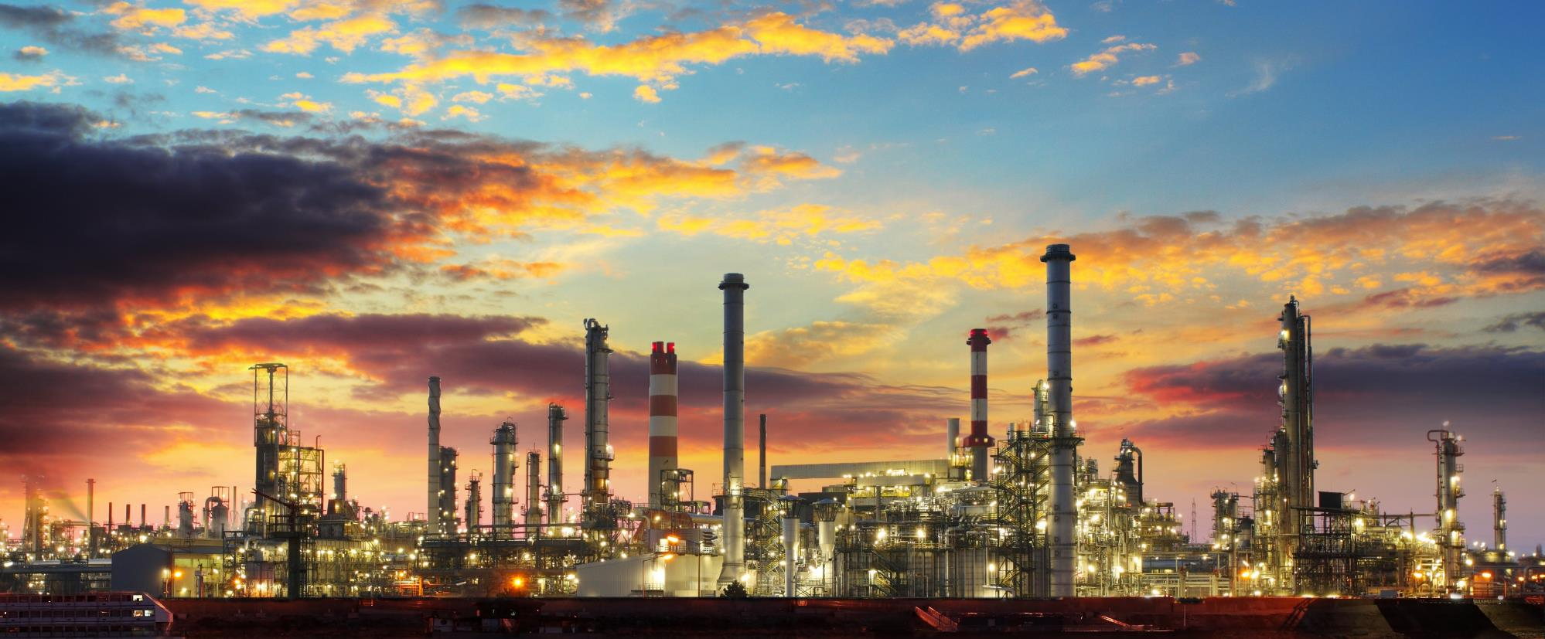

Novel Sulfur Removal Pathways
To Aid Energy Reduction and Decarbonization

Slide 2
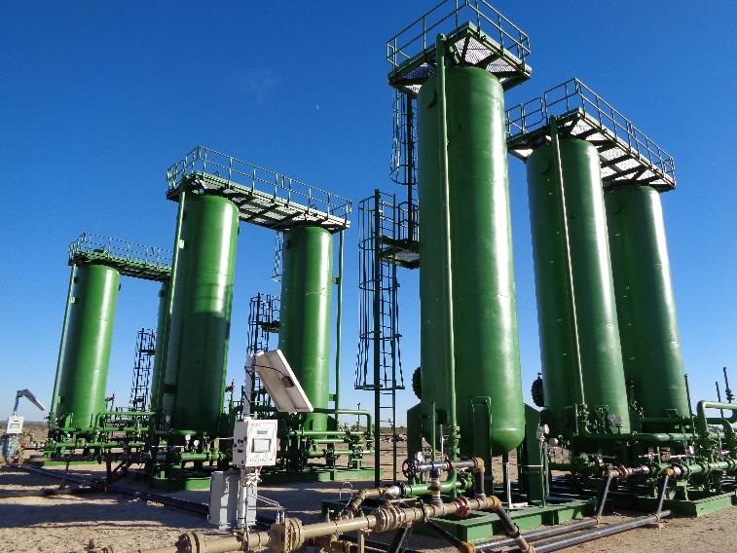


Who is GTC Vorro . . .
US privately-owned company in business since 2014 based in Houston, Texas, delivering engineered solutions. Two divisions:
Environmental Services Focused on removing harmful H₂S from upstream and midstream natural gas on a turnkey basis. 60 units in operation.
Technology Licensing Focused on
  Innovative Sulfur Removal Pathways
  Refining and Petrochemical Technologies
  Energy Transition: CO₂ utilization and Green H₂
Operating West Texas location

Slide 3
Presentation Focus
SweetTreat-OTM : Fuel Gas Sulfur Removal
NanoSØRBTM : LPG, FCC Gasoline and Diesel Sulfur Removal

Slide 4
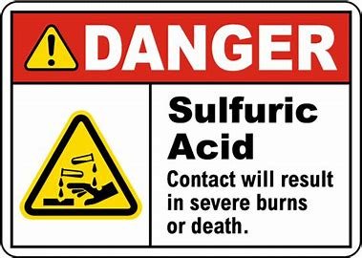

Fuel Gas
Typically 20-100 ppm S, controlled by amine system.
Usually set to meet an overall site emission limit.
Primary S species: H₂S and light mercaptans.
Sulfur compounds convert to SO₂ and SO₃. SO₃ reacts with water to form H₂SO₄.
To avoid condensation, flue stack is kept at elevated temperature.

Slide 5
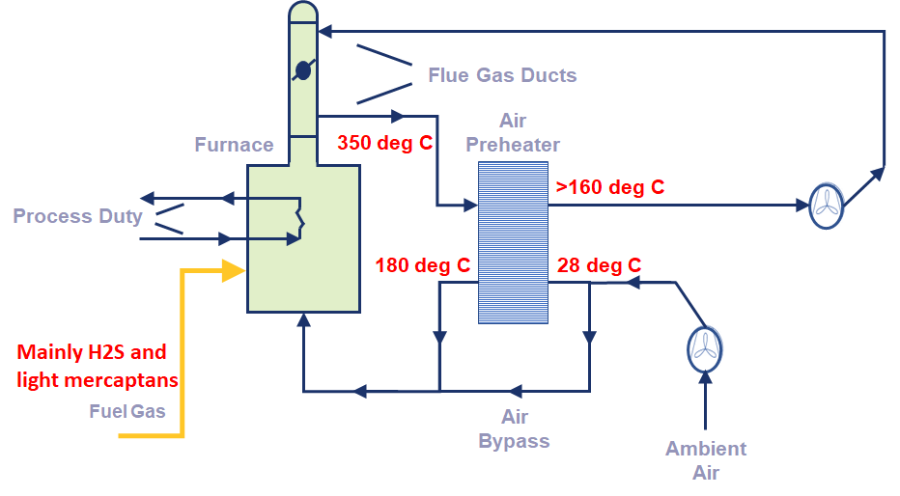
Example of Air Pre-heater Operation
Artificially
Kept high
Robust, but inefficient energy utilization operation due to deliberate high stack outlet temperature.
60 deg C window of heat recovery possible across Air Preheater.

Slide 6
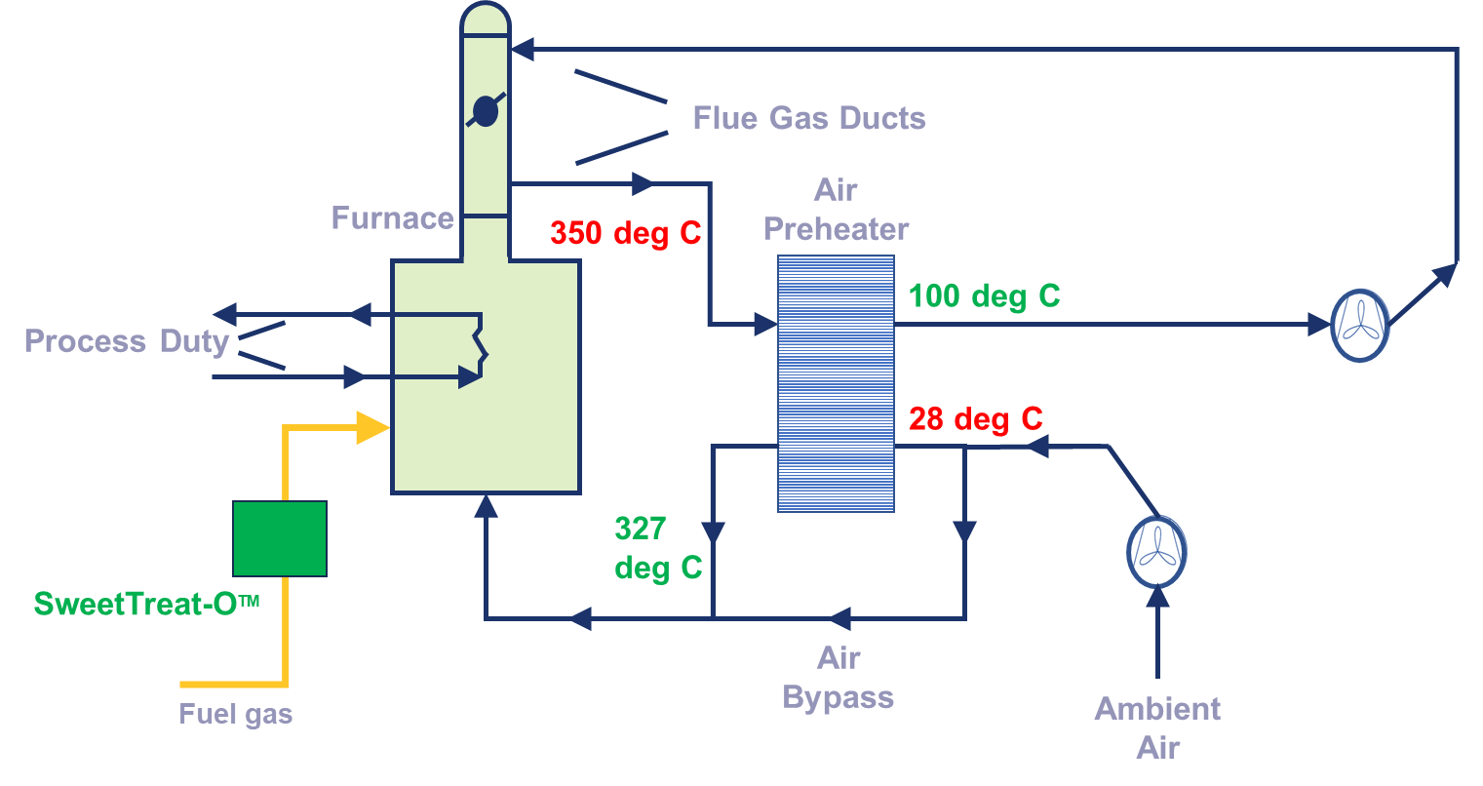
Air Pre-heater Optimized Operation
4-6% overall energy savings
System Payback period < 1 year
Minimal CO₂ and SO₂ emissions

Slide 7
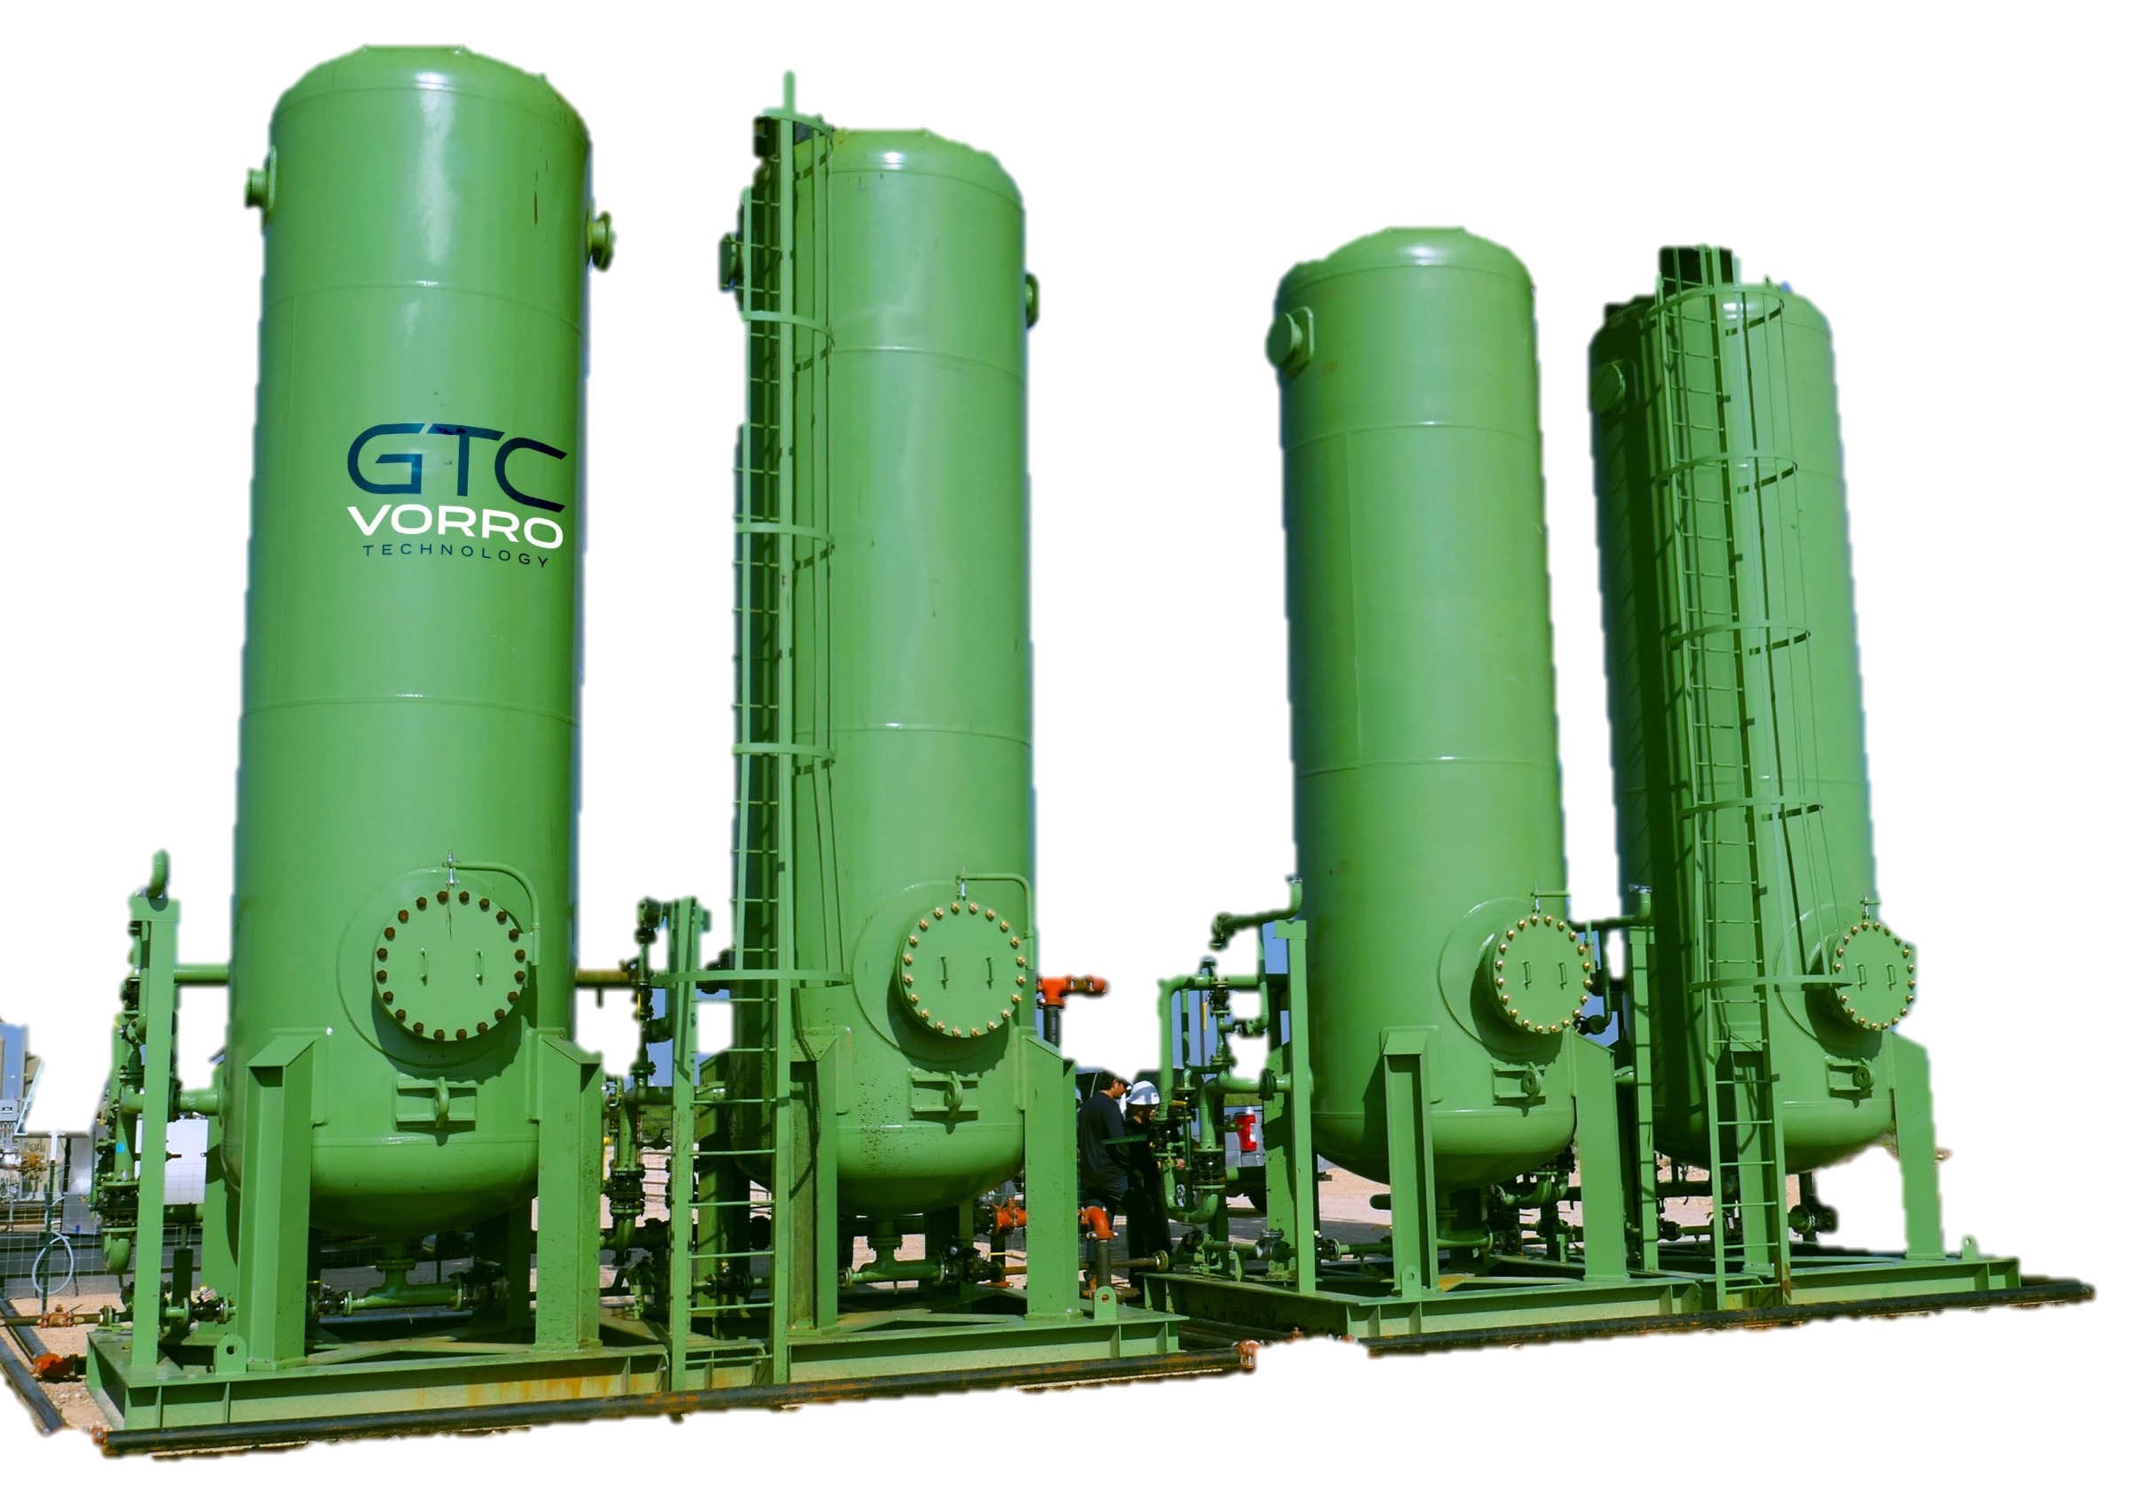
SweetTreat-O™
Proprietary mixed metal oxide- hydroxide based solid adsorbent for H₂S and light mercaptan removal.
Exceptionally high H₂S removal capacity: 120 wt% loading!
Optimal combination of different media achieves <1 ppmv TOTAL S.
Expected Acid Dewpoint at <1 ppmv TOTAL S in Fuel Gas: 75-85 deg C.
Minimal Pressure Drop (<2 psi)

Slide 8
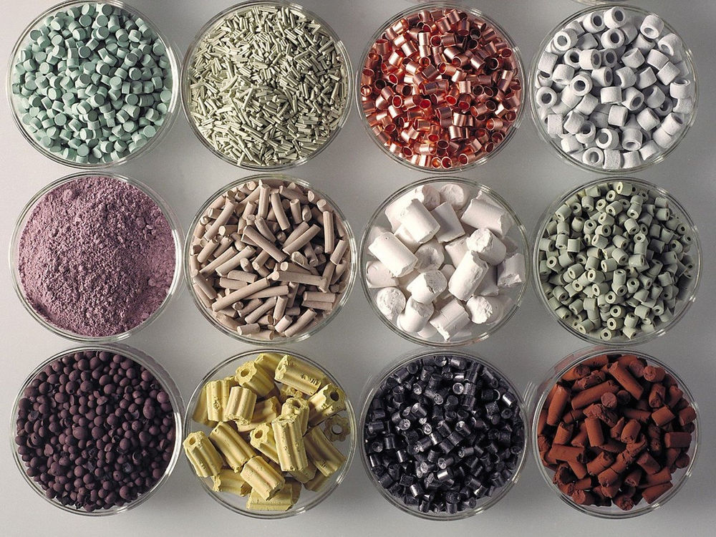
Introducing Catalytic Adsorption: NanoSØRBTM
Singular dimension nano-wire technology gives much higher dispersion of metals with improved activity and selectivity.
Revolutionary improvement compared to current-state-of-the-art.
Capable of removing H₂S, Mercaptans, Disulfides and Thiophenes.
Regenerable media. Ideal for fine sulfur removal.

Slide 9
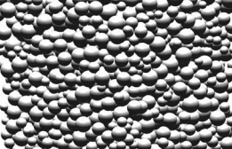
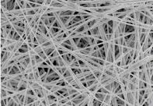
Metals Dispersion
Traditional Metals Deposition Nanowire Structure
Packing of spherical
powders: sinter over time –
Lose surface area and activity
Packing of nanowires: No sintering and loss of area, resulting in higher lifetime

Slide 10
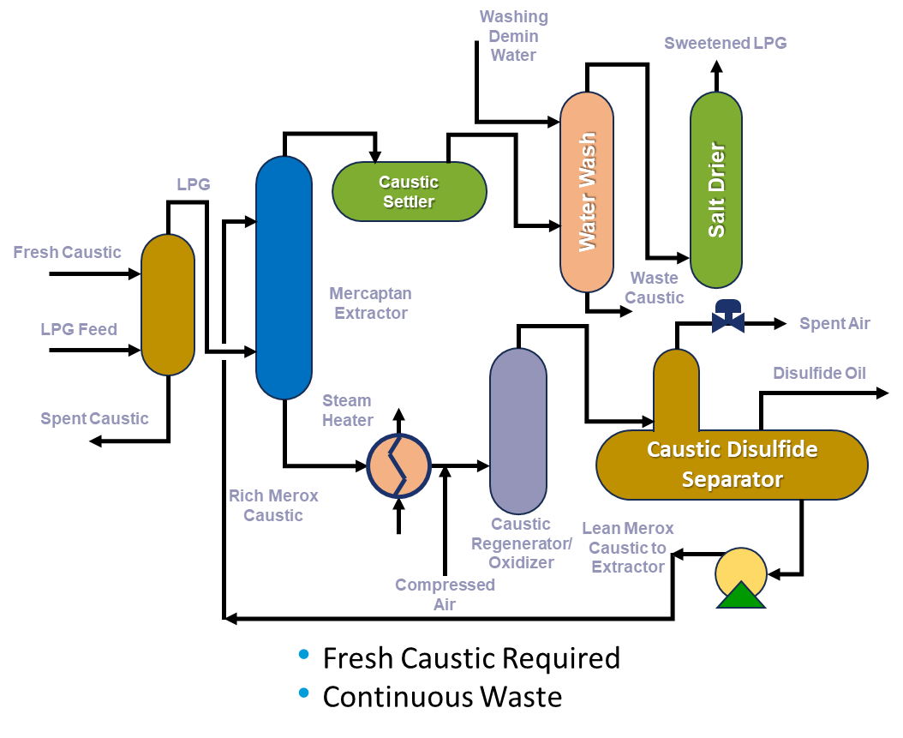
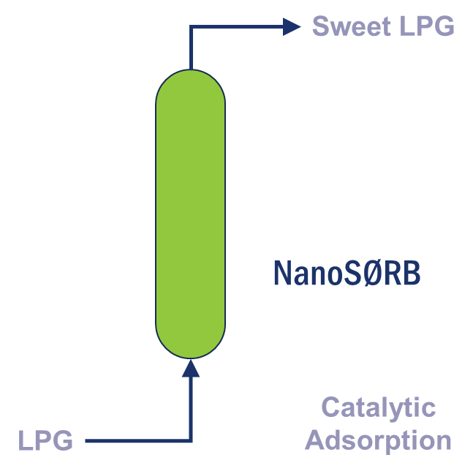
LPG - Caustic Treater Option
Regenerable Media
Eliminates Waste Caustic

Slide 11
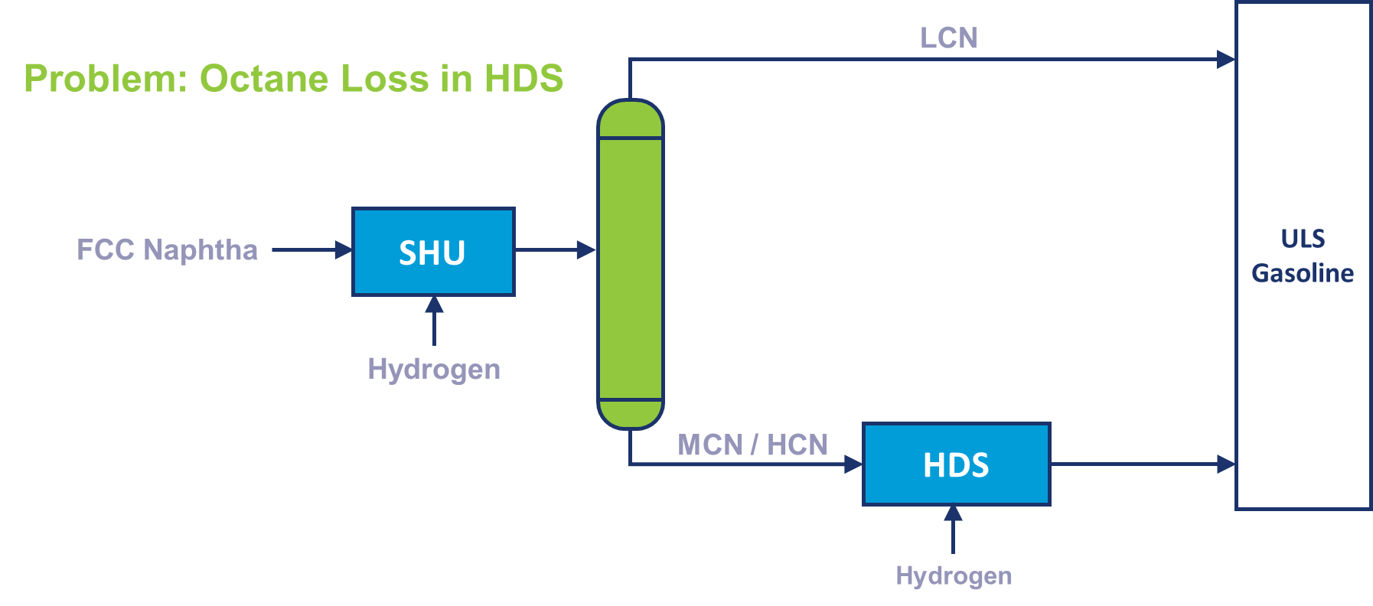
FCC Gasoline - Typical Hydrotreating/Desulfurization Process

Slide 12
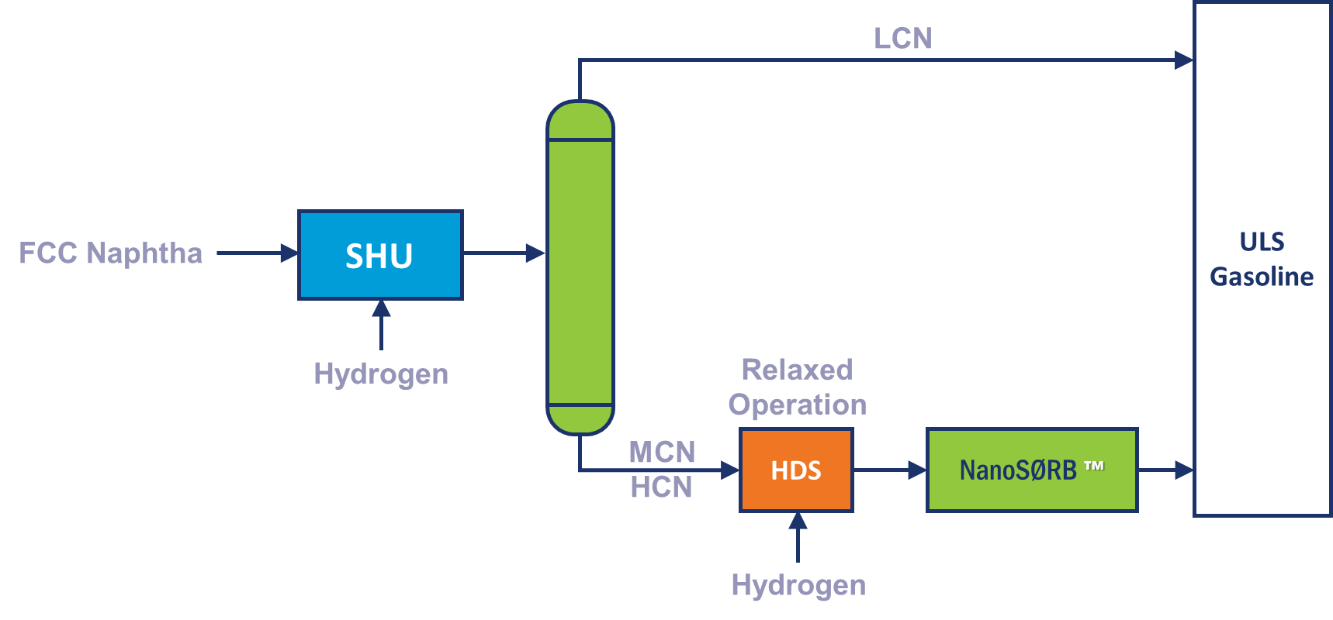
Polishing by Chemisorption
RON value is retained by relaxing severity in the HDS
Chemisorption removes the final sulfur traces, with near-zero octane loss
Fully regenerable media

Slide 13
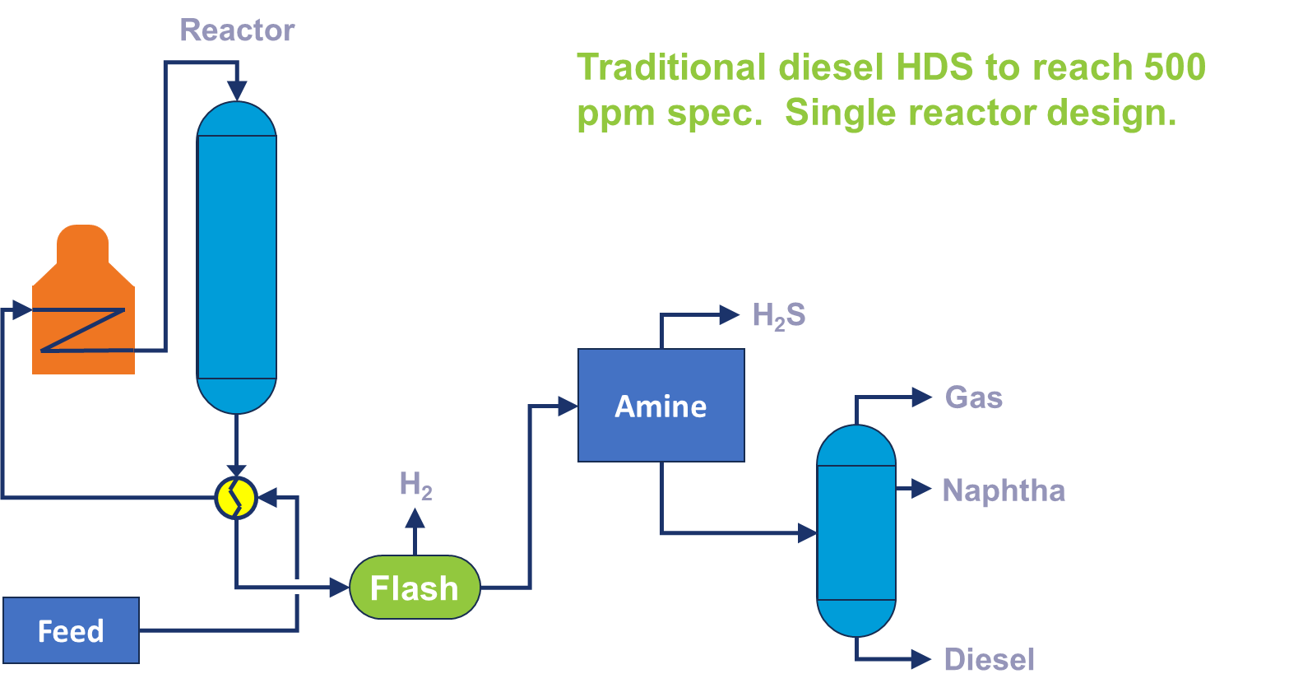
Diesel Desulfurization

Slide 14
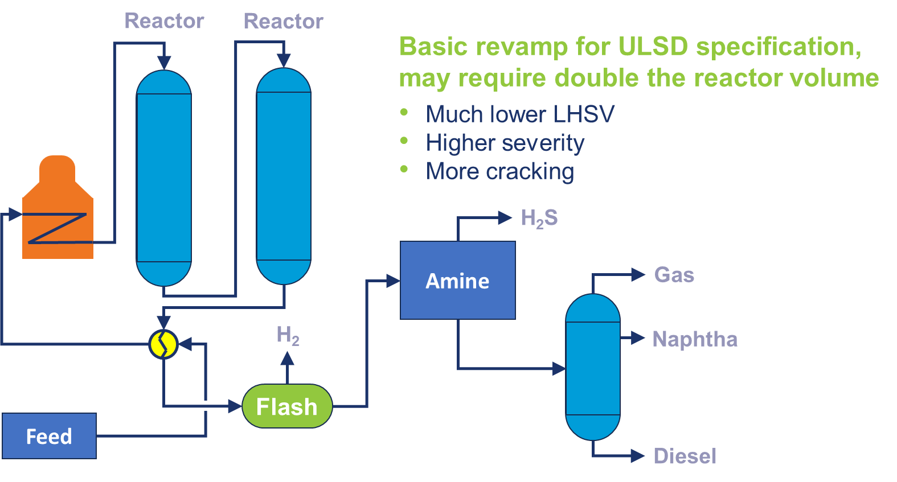
ULSD with New, Full-size Reactor

Slide 15
ULSD with Catalytic Adsorption Polishing System
Reactor
Single HDS reactor
Lower CAPEX
Easy revamp
Less cracking
Lower H₂ consumption
Reduced catalyst quantity
H₂S
Amine
Gas
H₂
Naphtha
Flash
NanoSØRB
Feed
Diesel

Slide 16
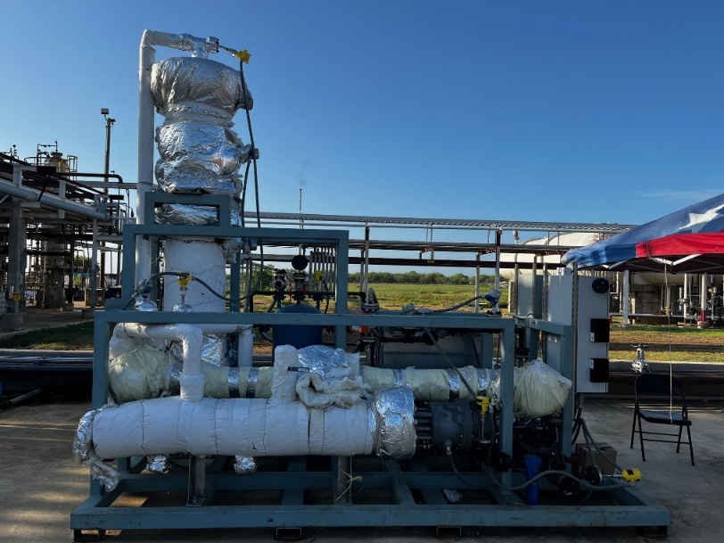
NanoSØRBTM Successful demonstration for ULSD: Texas refiner
Diesel feed flowrate: 1.5 gpm (51 BPD)
LHSV = 2 hr⁻¹.
Pressure at product separator: 200 psig
Average temperature of reactor: 650 ºF
H₂/HC ratio: 300SCF/bbl (54Nm³/m³)
Refiner is kickstarting engineering for 4000 bpd unit

Slide 17
Successful demonstration for ULSD: Texas refiner
Data Point | Reactor T (ºF) | Reactor P (psiG) | Diesel Feed Rate (GPM) | LHSV (hr⁻¹) | Hydrogen (SCFM) | Sulfur In (ppmw) | Sulfur Out (ppmw)
#1 | 651 | 200 | 1.18 | 2.5 | 8.5 | 270-300 | 12
#2 | 660 | 200 | 1.18 | 2.5 | 8.5 | 270-300 | 11
#3 | 659 | 200 | 1.18 | 2.5 | 8.5 | 270-300 | <5
#4 | 659 | 200 | 1.18 | 2.5 | 8.5 | 270-300 | <5
#5 | 660 | 200 | 1.18 | 2.5 | 8.5 | 270-300 | 7
#6 | 659 | 200 | 1.18 | 2.5 | 8.5 | 270-300 | <5
#7 | 660 | 200 | 1.18 | 2.5 | 8.5 | 270-300 | <5
#8 | 661 | 200 | 1.18 | 2.5 | 8.5 | 270-300 | 4
#9 | 660 | 200 | 1.18 | 2.5 | 8.5 | 270-300 | <5
#10 | 660 | 200 | 1.18 | 2.5 | 8.5 | 270-300 | 5
#11 | 660 | 200 | 1.18 | 2.5 | 8.5 | 270-300 | 13
#12 | 661 | 200 | 1.18 | 2.5 | 8.5 | 270-300 | 10
#13 | 659 | 200 | 1.2 | 2.5 | 8.5 | 270-300 | 8
Detection limit of TOTAL S analyzer is 5 ppmw

Slide 18
Summary
Development of new media and catalysts opens doors for:
  SO₂ emissions compliance
  Achieving higher energy efficiency
  Decarbonization
Fuel Gas, LPG, FCC Gasoline and Diesel are ripe candidates to achieve above goals via deployment of SweetTreat-OTMand NanoSØRBTM.

Slide 19
Rahul Khandelwal
Business Director
rkhandelwal@gtcvorro.com
CONTACT US
900 Threadneedle St.
Suite 500
Houston, TX 77079
C: +1 832-606-9639
www.gtcvorro.com

